Slide 1


Accessibility For All

Slide 2
contents
Introduction to Bobcats Access
Purpose of the Website
Features of Bobcats Access
How to use Bobcats Access
Benefits for disabled individuals
Conclusion

Slide 3

INTRODUCTION TO BOBCATs ACCESS
Accessibility is crucial for students and visitors with disabilities to navigate campus freely and independently.
Bobcats Access is an online platform designed to help individuals locate accessible features across Texas State University.
The website helps users find essential resources like ramps, elevators, and automated doors, ensuring that all members of the community can access the facilities they need.

Slide 4

Purpose of the website
Bobcats Access aims to create an inclusive campus environment by offering easy navigation for individuals with mobility challenges.
The website's core purpose is to provide accessible routes and features, such as ramps, elevators, and automatic doors, for users who need them.
This platform ensures that students, faculty, and visitors can efficiently navigate the campus without unnecessary barriers.

Slide 5

Features of bobcats access
Interactive Map: The website features an interactive map where users can zoom in on campus buildings to see which ones have accessible features.
Search Filters: Users can filter the map by specific types of accessibility features (e.g., elevators, ramps, automated doors).
Contact Information: For assistance, the website provides contact details to report issues or ask for further support.

Slide 6

How to use bobcats access
Navigate to the Bobcats Access website on your device.
Zoom in and explore the interactive map to view specific access points.
Filter by accessibility features, such as ramps, automated doors, and elevators, to see the corresponding locations.
Click on any location to view detailed information, including photos or floor plans (when available).

Slide 7

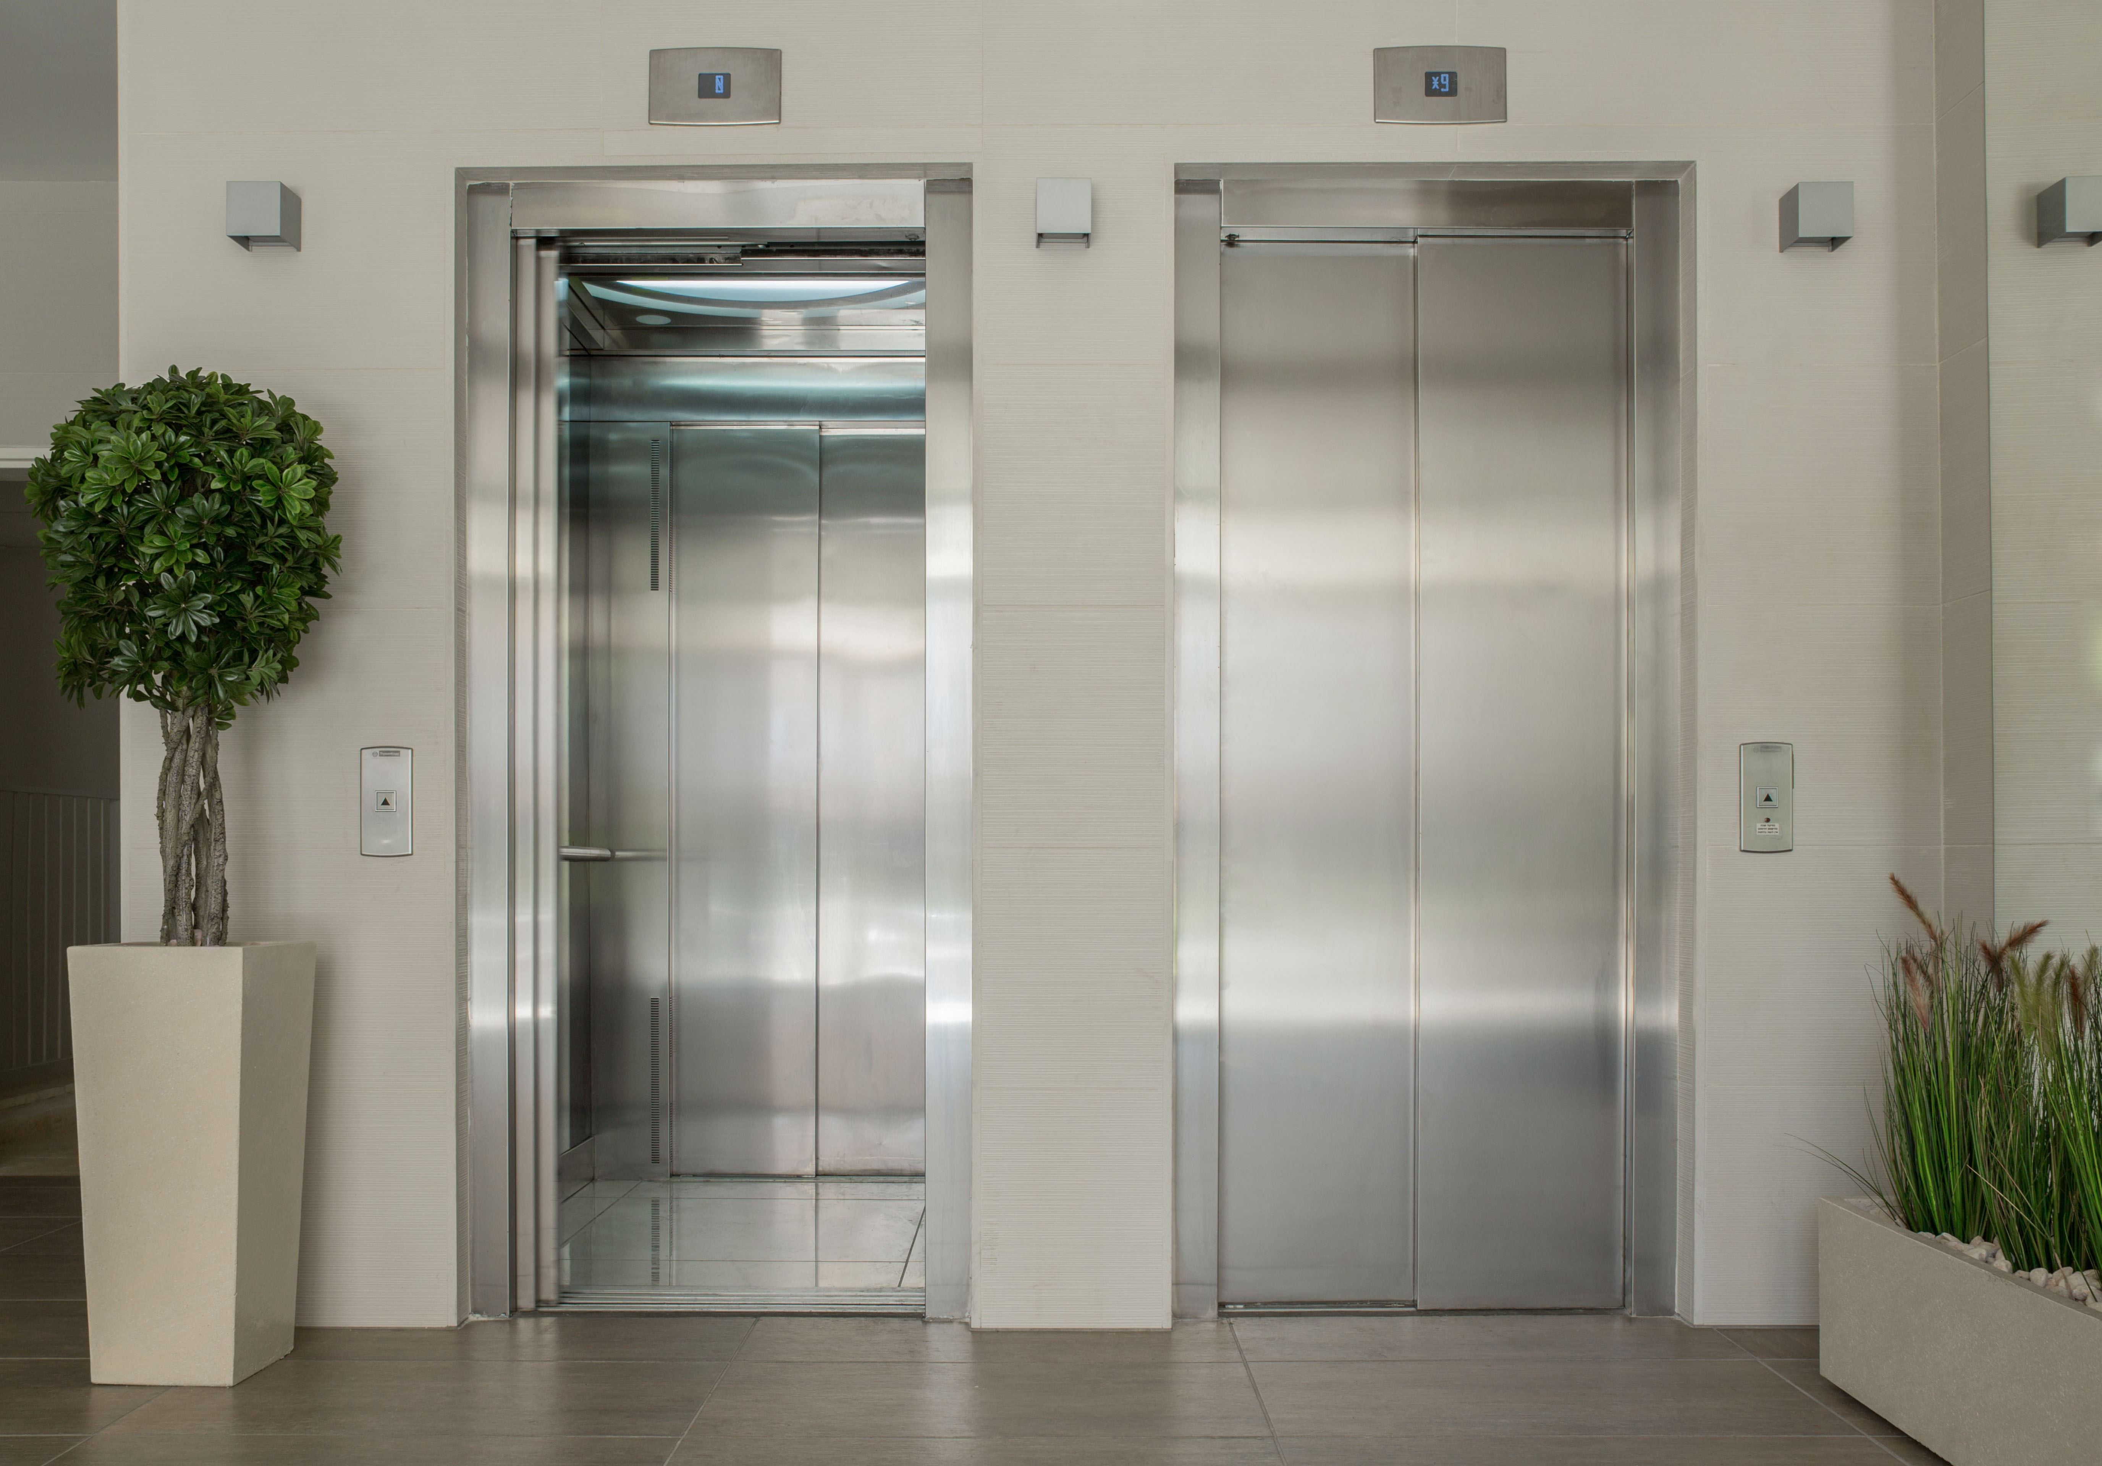
Benefits for disabled individuals
Ease of Navigation: Students and visitors can easily find accessible routes to classrooms, libraries, dining halls, and other essential locations.
Safety: In emergencies, knowing the accessible pathways can make a significant difference in ensuring safety and quick evacuation.
Convenience: The website saves time by helping users plan their routes ahead of time, eliminating the need to search for elevators or ramps on the fly.

Slide 8
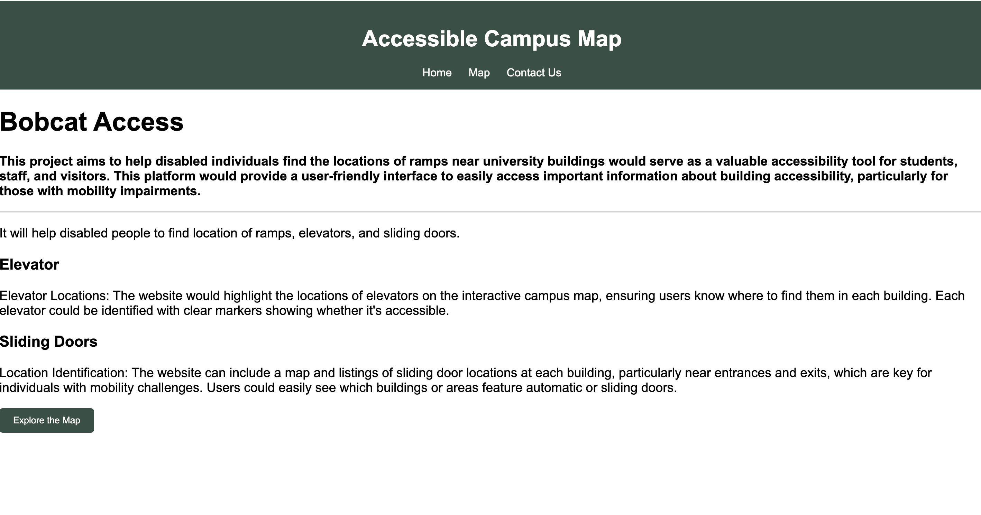

Slide 9
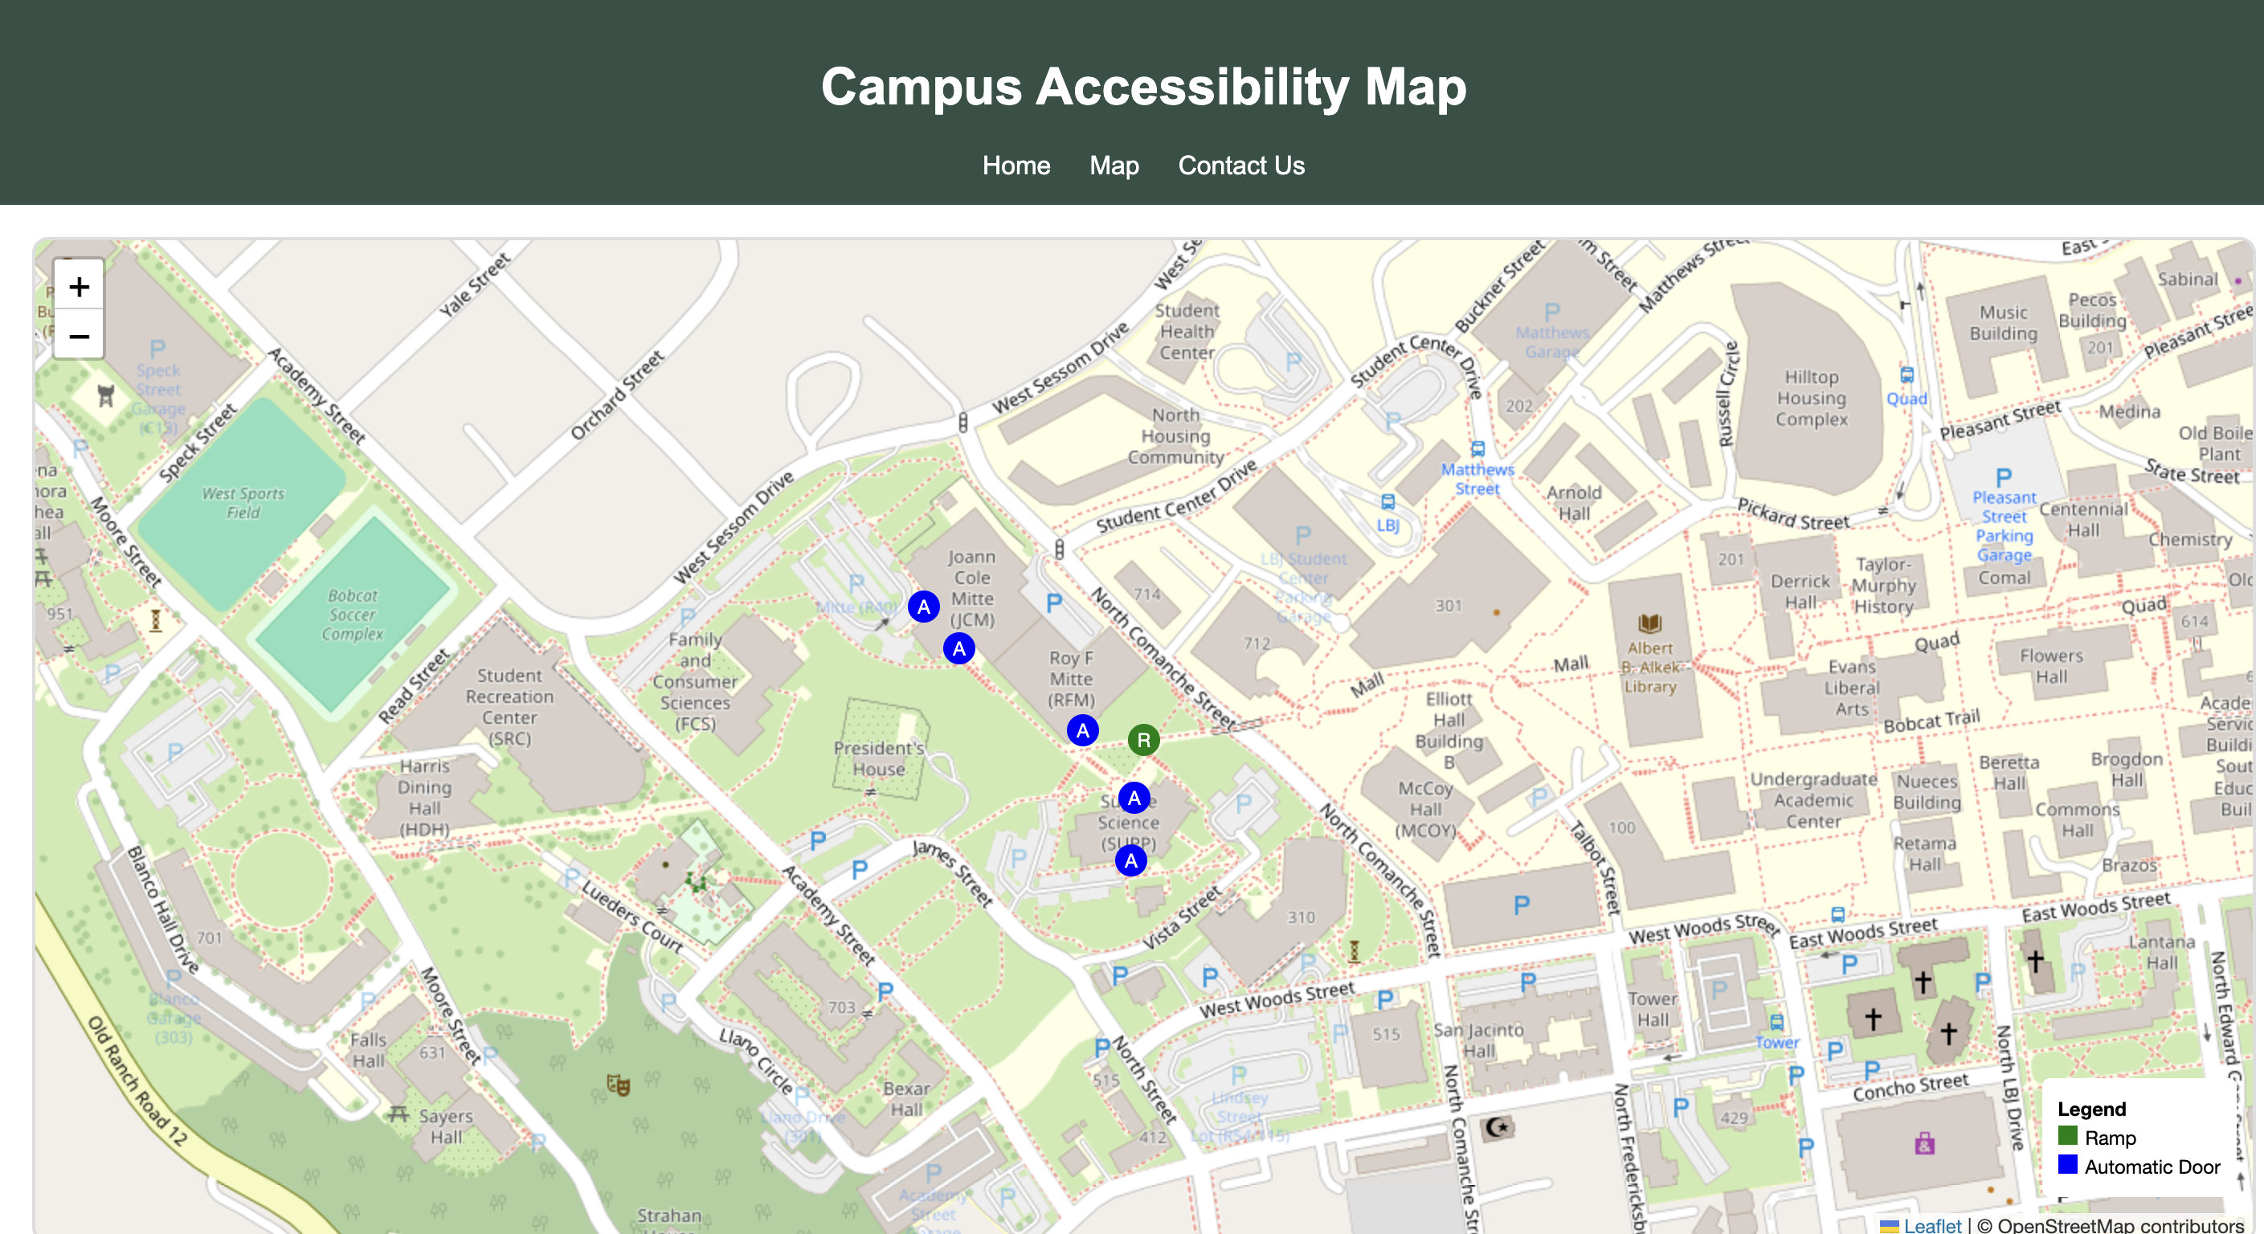

Slide 10
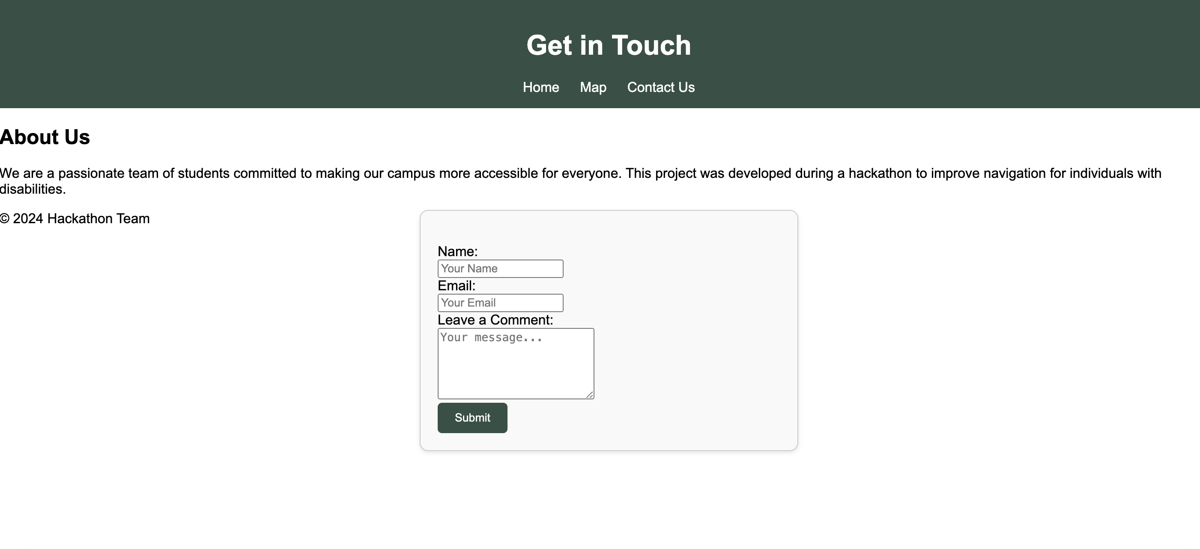

Slide 11
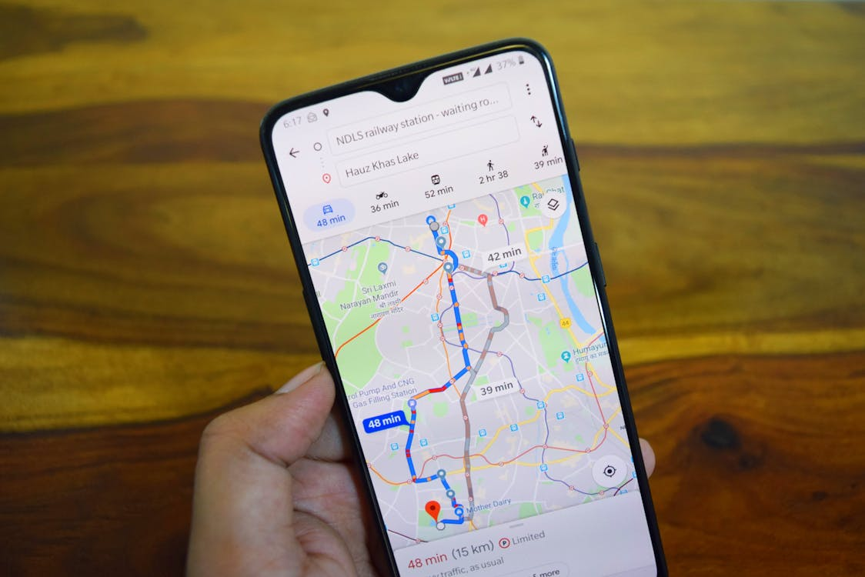
Conclusion
Bobcats Access is a vital tool in making Texas State University more inclusive and accessible for everyone, regardless of their mobility needs.
The platform helps students, faculty, and visitors find key accessibility features such as ramps, automated doors, and elevators.
It’s important that all students and staff familiarize themselves with Bobcats Access to make the most of this valuable resource.

Slide 12


THANK YOU!
Hackathon (Group 11)

